Slide 1
Using Stable Diffusion to generate high-quality image
By The REPLY List

Slide 2
Pre-trained Model used: Stable Diffusion 2.1.768
VAE architecture used:
https://huggingface.co/Linaqruf/personal-backup/resolve/main/vae/animevae.pt",
https://huggingface.co/hakurei/waifu-diffusion-v1-4/resolve/main/vae/kl-f8-anime.ckpt",
https://huggingface.co/stabilityai/sd-vae-ft-mse-original/resolve/main/vae-ft-mse-840000-ema-pruned.ckpt"

Slide 3

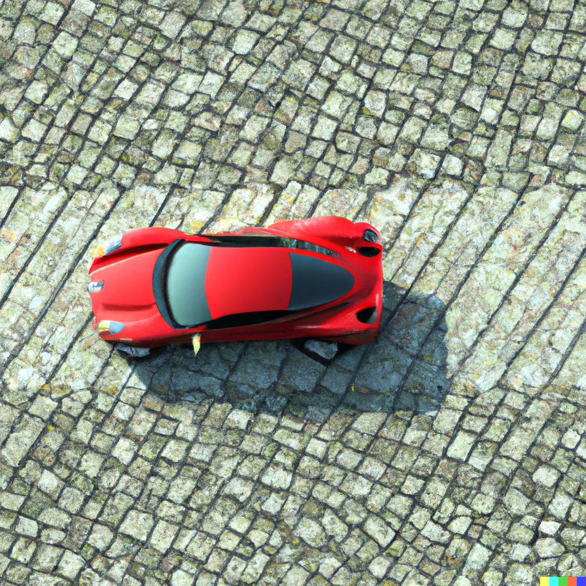
Data Acquisition
We used high-quality images from https://unsplash.com/ (with manual labelling) as well as generated image from DALL-E (with text prompt as labels).
We also used a pre-trained framework BLIP as a complementary tool for captioning the image.
We used 9 [image, caption] tuples as our training set.
Car, dirt road, sunny day, mytag
Car, cobbled street, sunny, mytag

Slide 4
Learning rate impact
As diffusion models tend to overfit very quickly, we fine-tuned on our different dataset with high and low learning rates, and we got better results with a low learning rate.
Batch size: 4
Training steps: 28
The above two parameters are set at this constant level for a balance between training time, memory usage and generalization performance
We use the same text prompt: “car, cobbled street, sunny, rainbow, mytag” to generate the output image. We decided that the output with a lower learning rate is better as it depicts the car tyres more realistically.

Slide 5
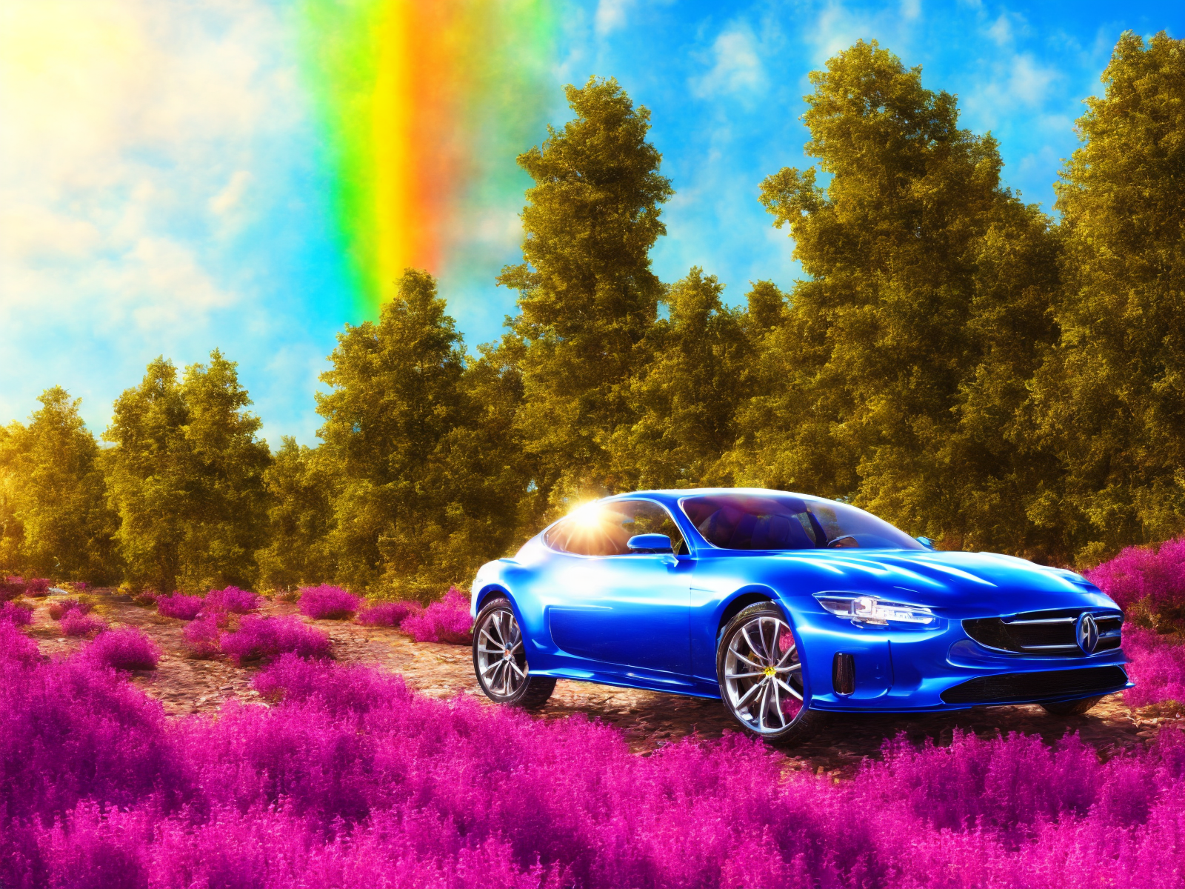
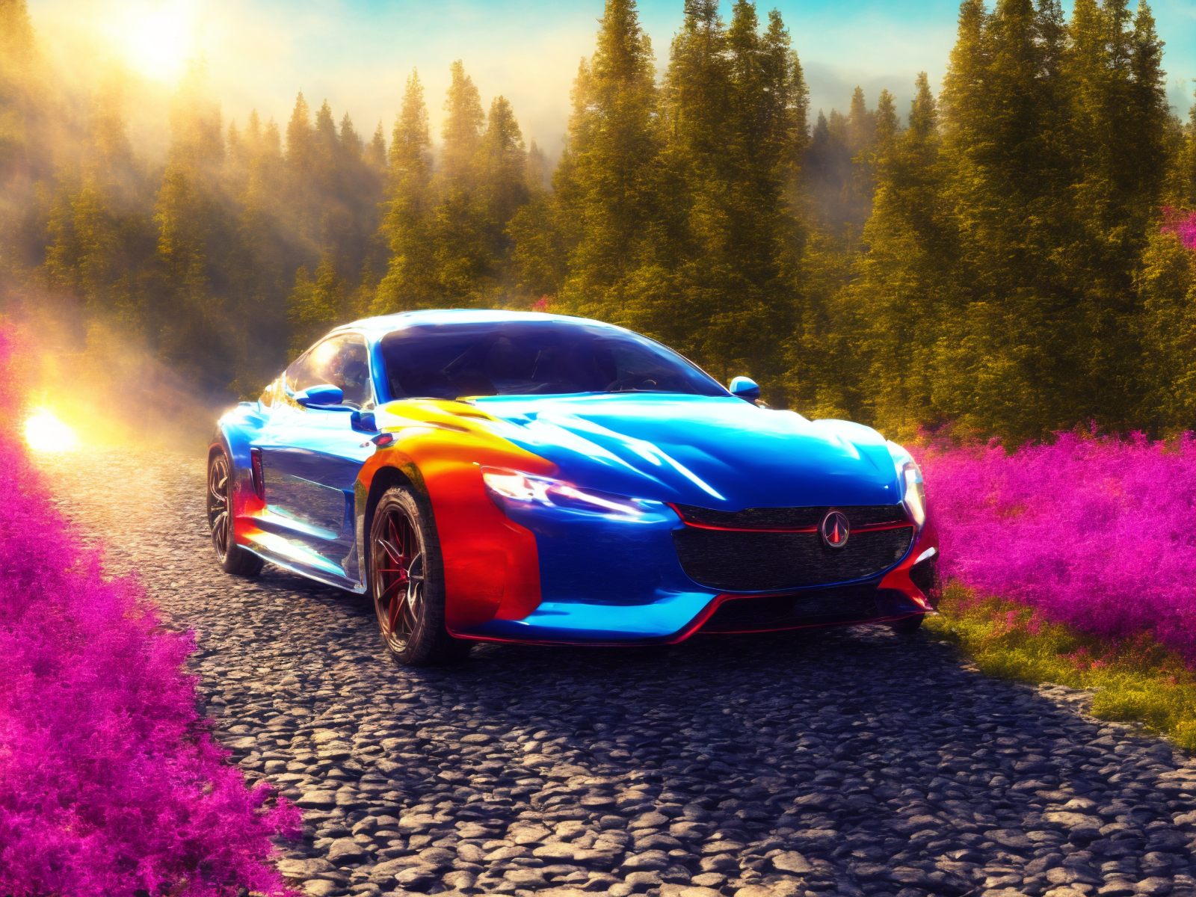
Output From Step 1
Learning rate: 1e-4
Learning rate: 1e-6

Slide 6
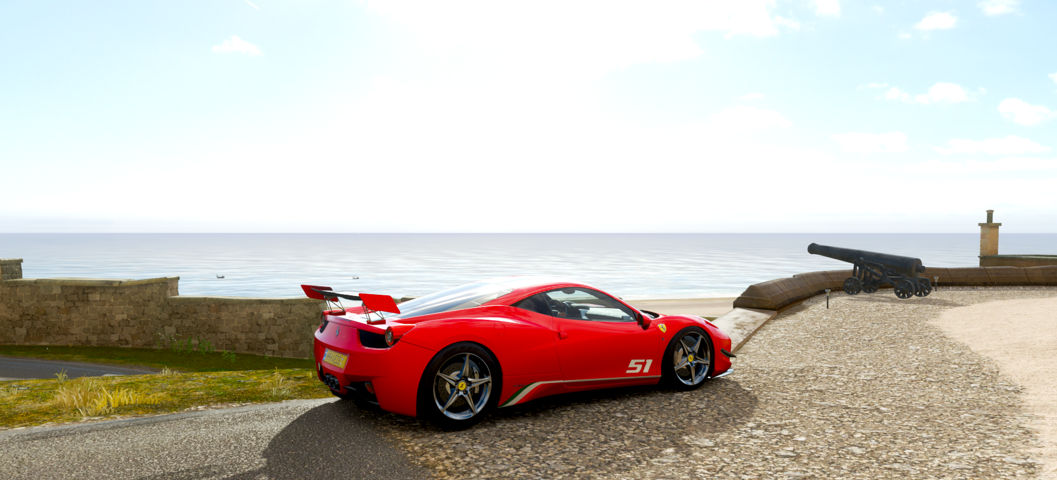
Control Net Impact
We used the control net to introduce an additional source of regularization into the training process.
Below is the image we used as the reference

Slide 7
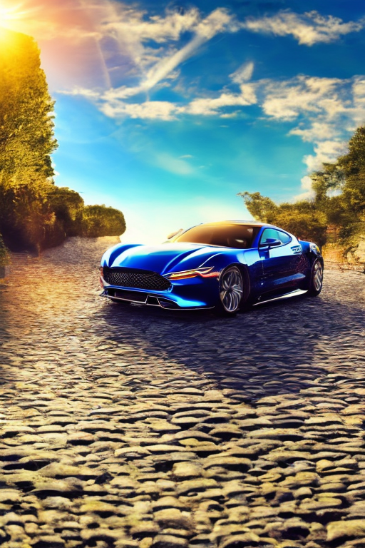
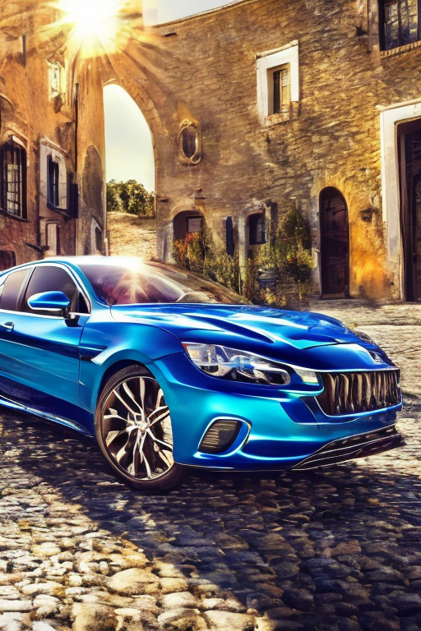
Comparison
Before
After

Slide 8
Image Inpainting
Here we observed generation of unrealistic or noisy samples, which could be due to the diffusion process amplifying small perturbations in the data.
We choose the masked inpainting technique to mitigate this problem.
Specifically, the model has used a VAE(mentioned earlier to accomplish this task). It uses an inpainting algorithm where we mask out unimportant details in our input data manually or randomly.
It also mask out the missing or corrupted parts of the image by automatically identify the regions of the image that need to be inpainted and create a binary mask to indicate which pixels should be filled in.

Slide 9
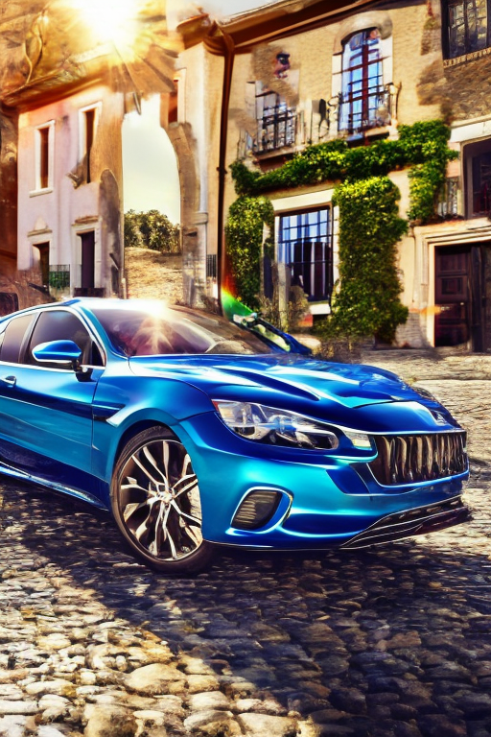
Image Inpainting
Here, since the training dataset is small, we manually flagged out the features we deemed as unimportant(simply by replacing those with black pixels), such as the trees/buildings besides the road.
Our final result is shown on the right.
Text prompt: car, cobblestone, sunny
day, mytag, high resolution

Slide 10
Further Development
For the inpainting algorithm, we still have quite a few steps wo be completed:
Postprocess the image: After the inpainting algorithm has been applied, it is often useful to postprocess the image to improve its visual quality and coherence with the surrounding pixels. This can include operations such as smoothing, sharpening, or color adjustment.
Preprocess the image: Before applying the inpainting algorithm, it is often useful to preprocess the image to enhance its features and remove noise. This can include operations such as denoising, sharpening, or contrast enhancement.
Evaluate the results: Finally, it is important to evaluate the quality of the inpainted image to ensure that it is visually pleasing and consistent with the original image. This can be done using subjective evaluations by human observers or using objective metrics such as Mean Squared Error (MSE) or Peak Signal-to-Noise Ratio (PSNR).

Slide 11
Further Development
Our solution have this rather obvious problem of overfitting. We can consider using the PNDM scheduler. By gradually increasing the complexity of the network architecture, the PNDM scheduler can help the model to adapt to the complexity of the data distribution without overfitting to the training data.
The PNDM scheduler can help the model to capture more intricate features of the data distribution and make more precise updates to the weights during training. This improves the stability and convergence speed of the training process, which has been the most time-consuming aspect in developing our solution.

